Slide 1



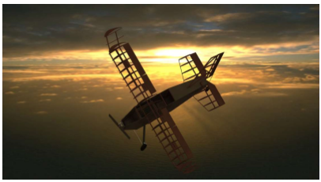
SAE Aero Design 2017 , Regular Class Gokaraju Rangaraju Institute of Engineering & Technology, Hyderabad (Department of Mechanical Engineering ) Technical Presentation
BRUISER HEADS

Slide 2
Project Planning
Project Approach
Simulating a fully functional Aerospace Engineering Firm
Herarchical Leadership Structure
Accountability , planning and safety
Compliance Officer
A student team member responsible to take compliance and safety
decisions. He has authority to take decisions in Safety and quality inspections.
Timeline based on engineering product development cycle
Faculty advisor
Team Captain
Group leads
Compliance officer
Engineers
Research and Trade studies
Modelling and Analysis
Manufacturing
Inspection
Testing
Sept & oct 2016
Nov 2016-jan 2017
Feb & mar 2017
Mar 2017
April 2017

Slide 3
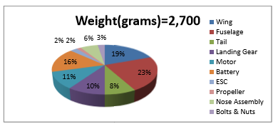
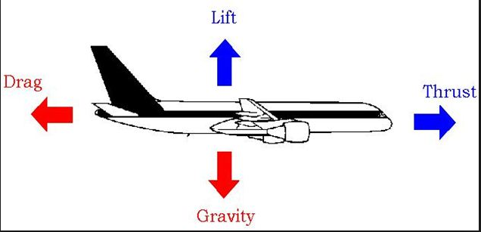
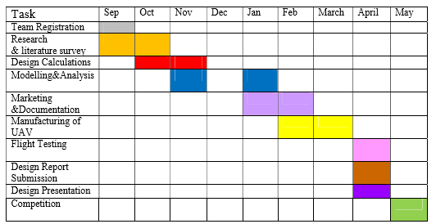
Requirements and Constraints
Performance Weight
Time Cost
Manufacturablility
Bruiser Heads
Design Envelope
Total Budget :
Rs 35,000

Slide 4
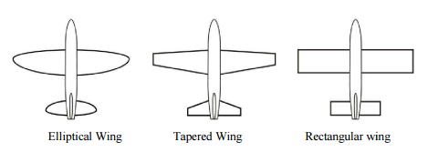
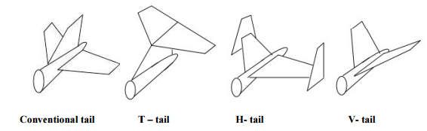
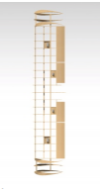

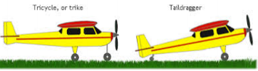
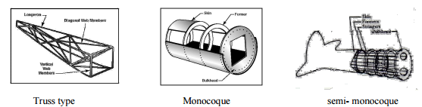
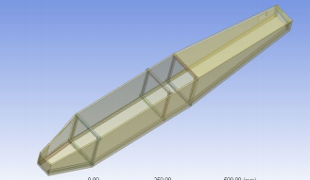
Trade Studies and Configuration Selection
Wing configuration Tail Configuration
Evaluation criteria Evaluation Criteria
Induced Drag Stability & Control
coefficient of lift Weight and Drag
manufacturability Manufacturability
Landing Gear Configuration Fuselage Configuration
Evaluation Criteria
Ease of Mounting
Usable Space
Moment of Inertia
Evaluation Criteria
Ground Stability and controllability
overturn Angle & Ease of Take Off

Slide 5
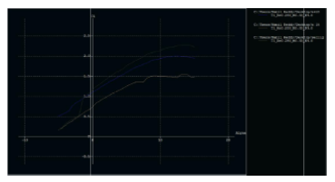
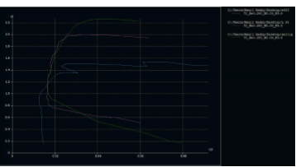
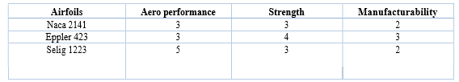
Airfoil Selection Different Airfoils are analysed in XFLR 5 analysis software
Cl vs α graph for different airfoils cl vs cd graph for different airfoils

Slide 6
VEHICLE SIZING
Design Decisions
Lift Requirement
Airfoil Selection
(Selig 1223)
Volume Coefficients
REQUIREMENTS
Payload Requirement
Wing Dimension
Vertical Stabilizer Dimension
Fuselage Dimension
Horizontal Stabilizer Dimension
Overall wing length is 58 inches
Fuselage length is 49 inches
Fuselage width is 5 inches
Volume coefficient of horizontal stab is 0.5
Volume coefficient of vertical stab is 0.04

Slide 7
Performance
Wing
Required lift : 6000 g
Assumed Speed : 30 kmph
Airfoil : Selig 1223
Optimisation of Aspect Ratio
(AR = 5.27)
Optimisation of Angle of Attack
Solving Span and Chord length
Horizontal Stabilizer
Dimensions are driven from volume coefficients and wing dimensions for pitch stability and wing downwash.
Length of horizontal stab = 21.6 inches
Width of horizontal stab = 4.32 inches
Vertical Stabilizer
Dimensions are driven by volume coefficients and wing dimensions to react propeller torque for roll stability .
Length of vertical stab = 11.4 inches
Height of vertical stab = 12 inches

Slide 8




Performance Calculations
Lift
Lift Force = CL * ½ * air density (rho) * V^2 * Wing Area
Drag
Our aircraft predicted take off time is 6 sec in 38 metres take off distance at a speed of 30 kmph
Takeoff Distance
Takeoff velocity
Servo sizing

Slide 9
Control Surfaces
Ailerons
Flaps
Elevator
Rudder
Chord ratio : 0.25 Span ratio :0.22 deflection angle: 25 degree
Chord ratio : 0.25 Span ratio :0.12 Deflection angle : 25 degree
Chord ratio : 0.4 Span ratio : 1 deflection angle : 30 degree
Chord ratio: 0.4 Span ratio: 1 deflection angle : 30 degree

Slide 10
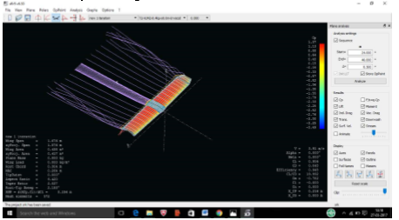
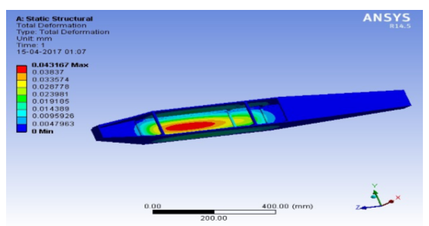
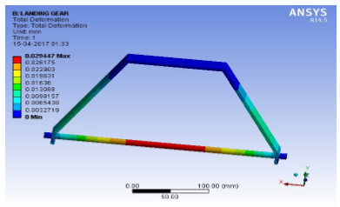
Fluid flow and Stress Analysis
Flow Analysis on Wing Stress Analysis on Fuselage
Stress Analysis on Main Landing Gear
Part | Analysis software | Failure mode | Factor of safety > 2 | Failure Criteria
Fuselage | Ansys | Bending | yes | Vonmises Stresses During Landing
Main Gear | Ansys | Bending and Shearing | yes | Vonmises Stresses During landing

Slide 11
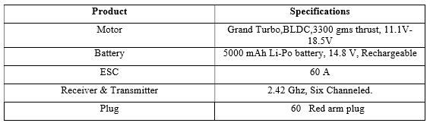
Motor Selection
Thrust to weight ratio (0.6)
Thrust
Weight of Plane (2.7 kg)
Chosen Kv Value (560)
Power to Thrust Ratio (0.22)
Power
Industry Recommendations
Motor
Propeller
Electronics Specifications :

Slide 12
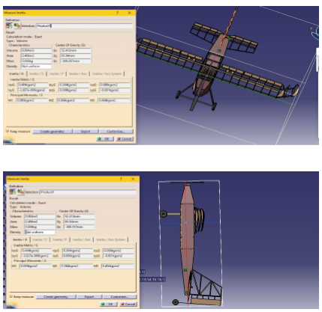
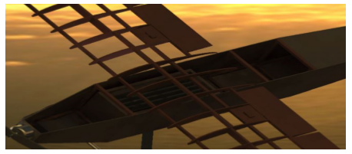
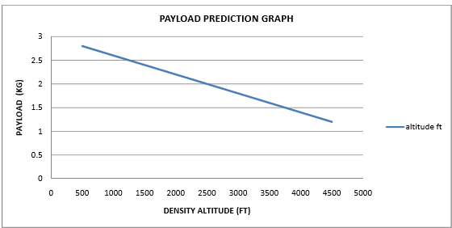
Center of Gravity
Payload
PAYLOAD (KG) = 3 – ( 4.62 X 10-4) X H

Slide 13
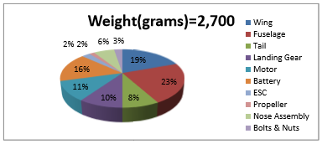
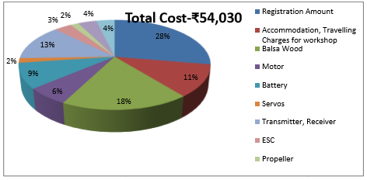
Materials Used
Part | Material | Description
Wing & Tail | Balsa wood | Balsa wood has better strength to weight ratio
Fuselage | MDF | As fuselage should carry even payload , strength is quite considerable factor. MDF has greater strength
Main Landing Gear | Aluminium | During landing , Landing Gear is subjected to shocks and impact load. So aluminium is better for that purpose
Weight Distribution
Cost Distribution

Slide 14
Innovation The most unique element in team design is steering of plane on ground.This has greatly improved controllability and safety of plane.
Results
s.no | Date | Result | Remark
1st Flight Test (without Payload ) | 2nd April 2017 | Unsuccessful | Improper attachment of landing gear
2nd Flight Test (without payload ) | 4th April 2017 | Successful | Stable in flight
3rd Flight Test ( With Payload ) | 7th April 2017 | Unsuccessful | C.O.G was not properly balanced
4th Flight Test ( with Payload) | 8th April 2017 | Successful | Stable in flight

Slide 15
THANK YOU

